Slide 1
10.1 Introduction to Cryptography
Cryptography Day 1

Slide 2
Class Objectives
By the end of today’s class, you will be able to:
Use basic transcription and substitution ciphers and keys to encrypt simple messages.
Understand how encryption supports secure communication through the PAIN framework.
Differentiate between encoding and encrypting.
Calculate the strength and efficiency of various encryption levels.
Use symmetric encryption tool OpenSSL to confidentially transmit secure messages.

Slide 3
Introduction to Cryptography

Slide 4

Cryptography is the art and science of keeping information secure through the use of mathematical concepts and techniques.

Slide 5
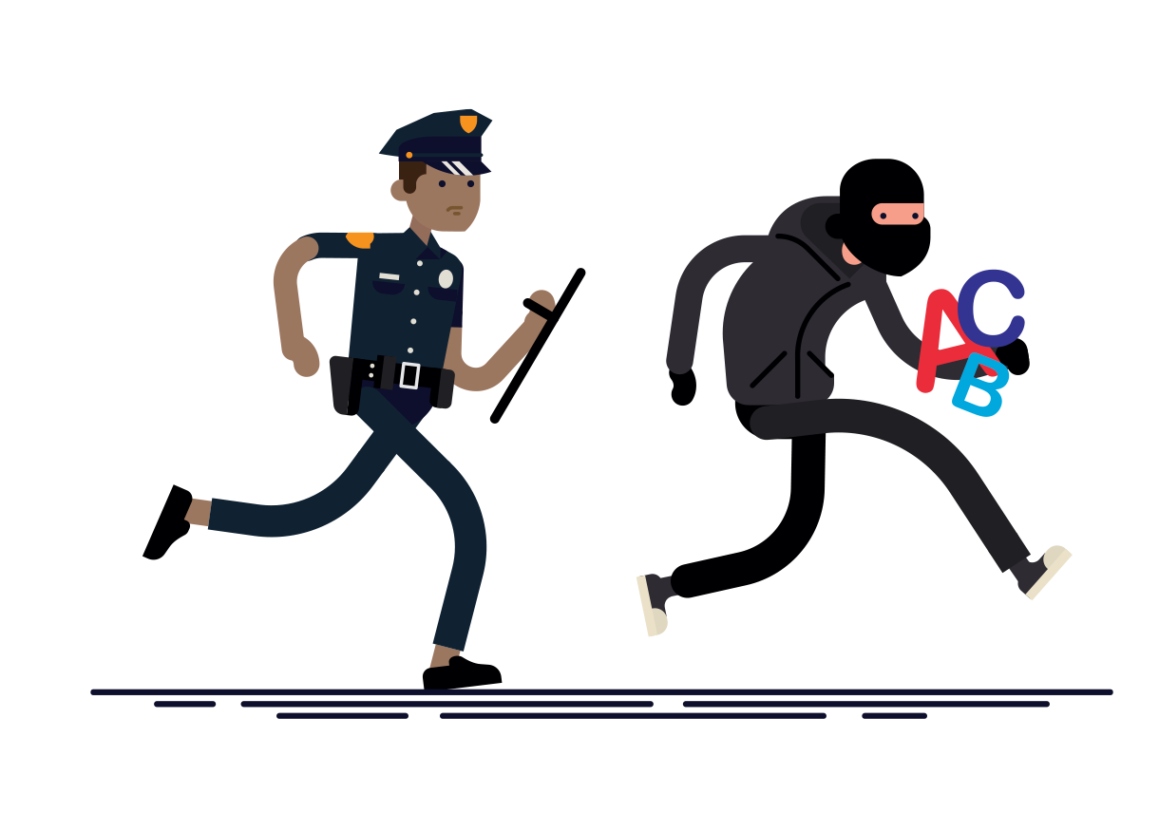
This Week’s Scenario
In today’s activities, we will be playing the role of security analysts at the Hill Valley Police Department.
You will be investigating the Alphabet Bandit, who is responsible for a number of burglaries in Hill Valley.
The Alphabet Bandit likes to leave hidden messages after each burglary, and we must use cryptographic techniques to investigate the incidents.
Notes:
Image source: shutterstock_711455560

Slide 6
The History of Cryptography

Slide 7
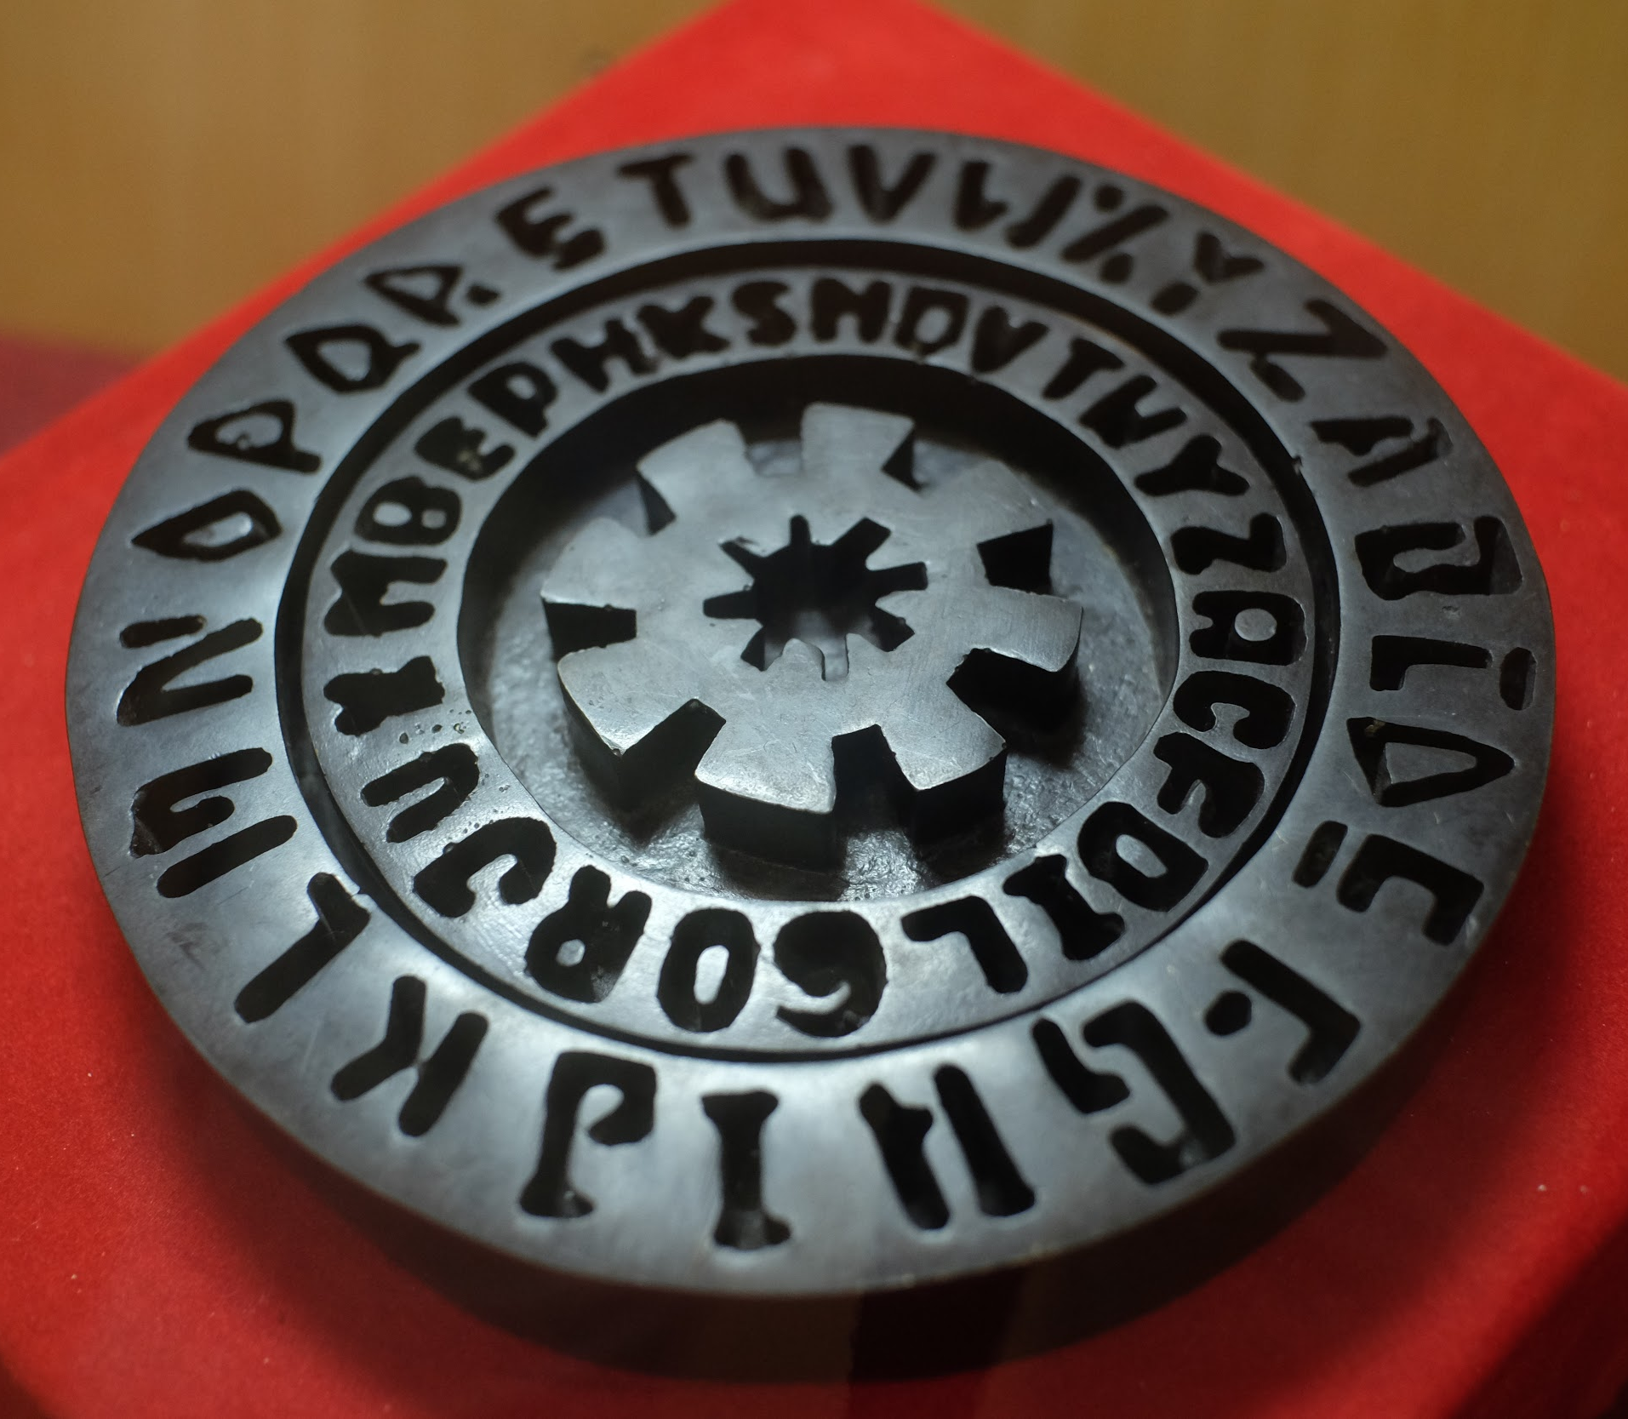
The Origins
While cryptography seems like a modern concept, cryptographic techniques were actually in use in early human civilizations.
Early civilizations engaged in battles, politics, and fights for supremacy. Individuals needed to find methods to communicate securely and keep these communications hidden from enemies.
Notes:
shutterstock_1445849924

Slide 8

The Caesar Cipher
They shall never crack my code!
In an effort to communicate with his military, the Roman general developed a cipher to hide his communication.
The Caesar cipher is a method of encryption, a process of modifying a message or information in such a way that prevents unauthorized parties from accessing it.
Encryption takes a plaintext message and converts it to an unreadable ciphertext message.
Caesar’s plaintext: “Launch an attack at sunrise.”
Encrypted ciphertext: “Odxqfk dq dwwdfn dw vxqulvh”
Notes:
Image source: shutterstock_92626915

Slide 9
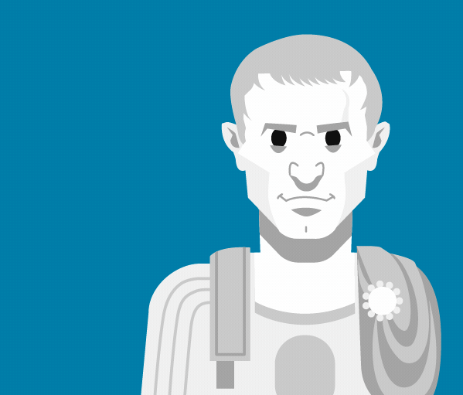
The Caesar Cipher
The goal of the cipher is to prevent unauthorized parties from reading the communications, and allow authorized parties to receive and understand the message.
This is accomplished through decryption, the process of converting ciphertext back into readable plaintext.
They shall never crack my code!
Encrypted ciphertext: “Odxqfk dq dwwdfn dw vxqulvh”
Decrypted paintext: “Launch an attack at sunrise.”
Notes:
Image source: Michael B. Myers Jr.

Slide 10
How the Caesar Cipher Works
The Caesar cipher works by shifting letters a set number (key) of positions from the original letter.
Original
Key = 2
A
B
C
D
E
F
G
H
I
J
Encoded
A
B
C
D
E
F
G
H
I
J
Examples
“I HID A CAB” → “K JKF C ECD”
“A BAD DAD” → “C DCF FCF”
Notes:
Diagram recreated

Slide 11
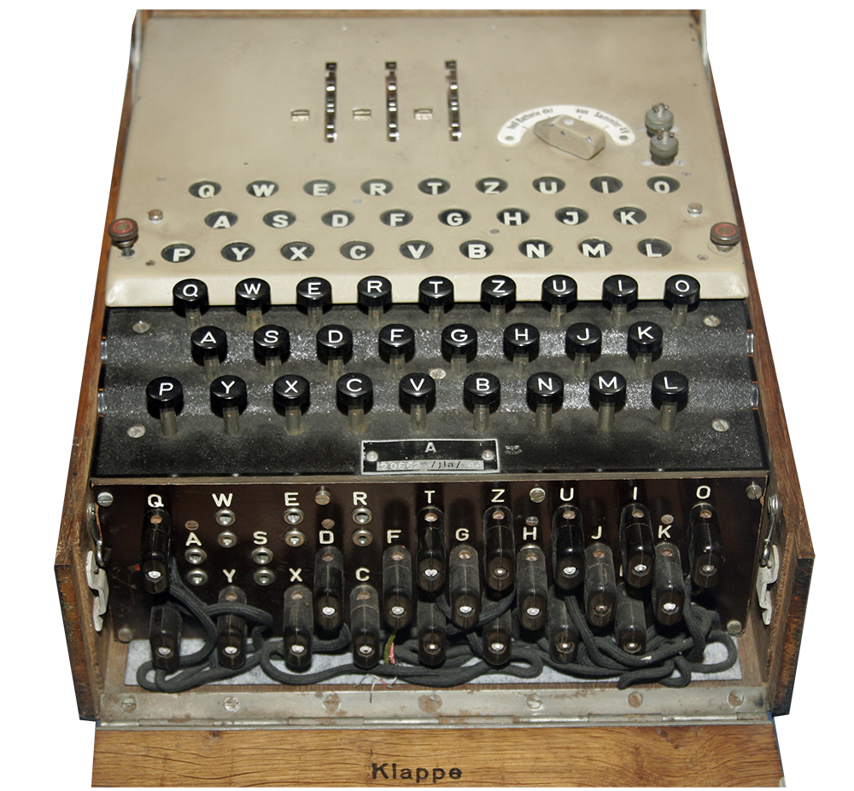

The Enigma Cipher
As technology advanced, applied cryptography became more complex and harder to crack.
Lampboard
After the end of World War I, Germany developed an advanced encryption tool known as the Enigma machine.
The machine scrambles the 26 letters of alphabet, allowing for billions of ways to encrypt a message.
Keyboard
Slots
Notes:
Image source: shutterstock_15364684

Slide 12
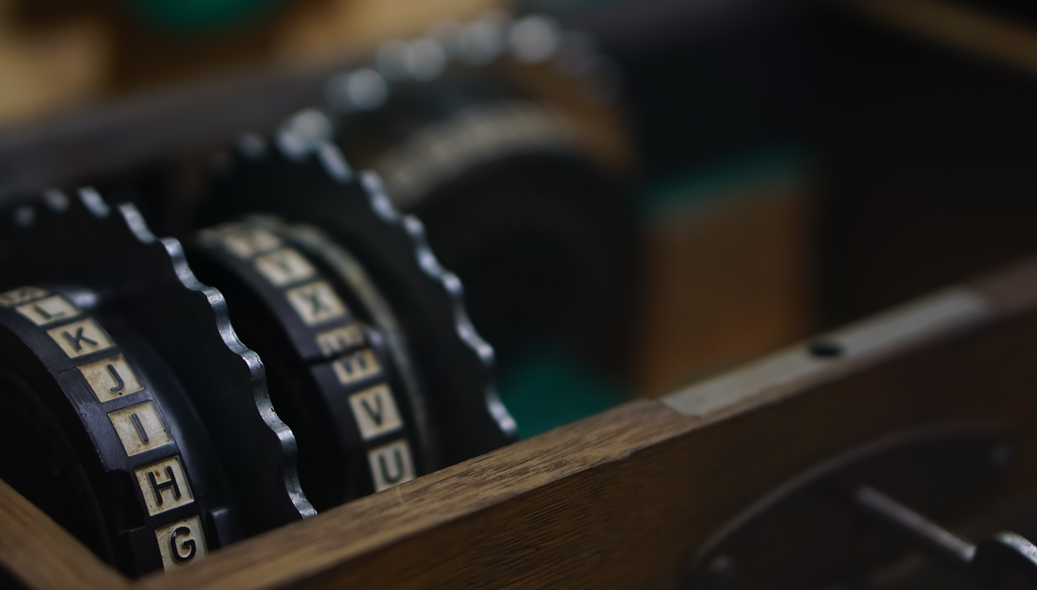
Enigma: Key Creation
Settings are configured by the user.
The key was created when the sender plugged wires into specific slots and arranged the roto settings.
The exact settings were then used by the recipient for decryption.
Notes:
Image source: shutterstock_585312227

Slide 13
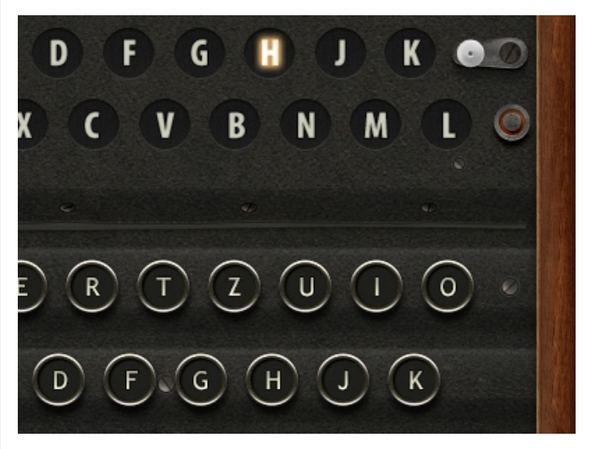
Enigma: Encryption
To encrypt, the sender typed the plaintext message on the machine’s keyboard one letter at a time.
After each letter was pressed on the keyboard, another letter lit up on the machine's lampboard.
The illuminated letters were documented, creating the ciphertext.
The ciphertext was transmitted
to the recipient.

Slide 14
Enigma: Decryption
The secret key combination was provided to the recipient in advance.
The key was used to configure the machine with the exact settings used for encryption.
The ciphertext was entered one letter at a time in the keyboard, illuminating the original plaintext on the lampboard.
Notes:
Image source: Mateusz Zdrzenicki

Slide 15

Cracking the Enigma
During the height of World War II, English mathematician and computer scientist Alan Turing developed a method to exploit the weaknesses of the Enigma machine’s design.
The creation of the Bombe helped decrypt the most complex versions of Enigma and is considered one of the Allied forces’ most important victories during the war.
Notes:
Image source: Wikipedia (public domain)

Slide 16
Summary
We’re learning a lot of new concepts this week. Let’s review!
Plaintext
Cipher
Information in human readable form.
Method of performing encryption or decryption.
Ciphertext
Key
Parameter specifying how plaintext is converted to ciphertext and vice versa.
Plaintext message that has been encrypted into an unreadable form.
Encryption
Caesar cipher
Type of cipher that shifts the letters in the alphabet by a fixed number.
Process of converting plaintext to ciphertext.
Decryption
Enigma cipher
Type of cipher used by Germany in World War II to encrypt messages.
Process of converting ciphertext to plaintext.

Slide 17
Activity: Caesar Cipher Code Names
In this activity, you will play the role of security analysts working for the Hill Valley Police Department.
You have been assigned to a top secret task force to find the Alphabet Bandit. You must create a code name, encrypt it, and send it to your partner.
10 Minutes

Slide 18
Character Encoding

Slide 19

Remember: computers transmit digital data through binary.
Therefore, encrypting data on computers first requires a method of alphanumeric representation, known as encoding.
Notes:
Image source: shutterstock_1083618569

Slide 20


Character Encoding
While encoding may seem similar to encryption, they have very different goals:
Encoding
Encryption
Used to transform data so it can be properly used by different type of system.
Not used to keep information secret.
Data is encoded with publically-available schemes that can be decoded by anyone.
Used to keep information from being accessed by unauthorized parties.
Does not use a key.
Uses a key to encrypt and decrypt.
Notes:
shutterstock_336715625

Slide 21
Binary Encoding
Remember: Binary is the basis of digital communication.
8 bits = 1 byte
1
0
0
1
0
0
0
0
One byte can range from 00000000 to 11111111
For example:
This conversion is called binary to decimal encoding.
00000000 = 0
11100000 = 224
11111111 = 255

Slide 22
ASCII stands for the American Standard Code for Information Interchange.

Slide 23
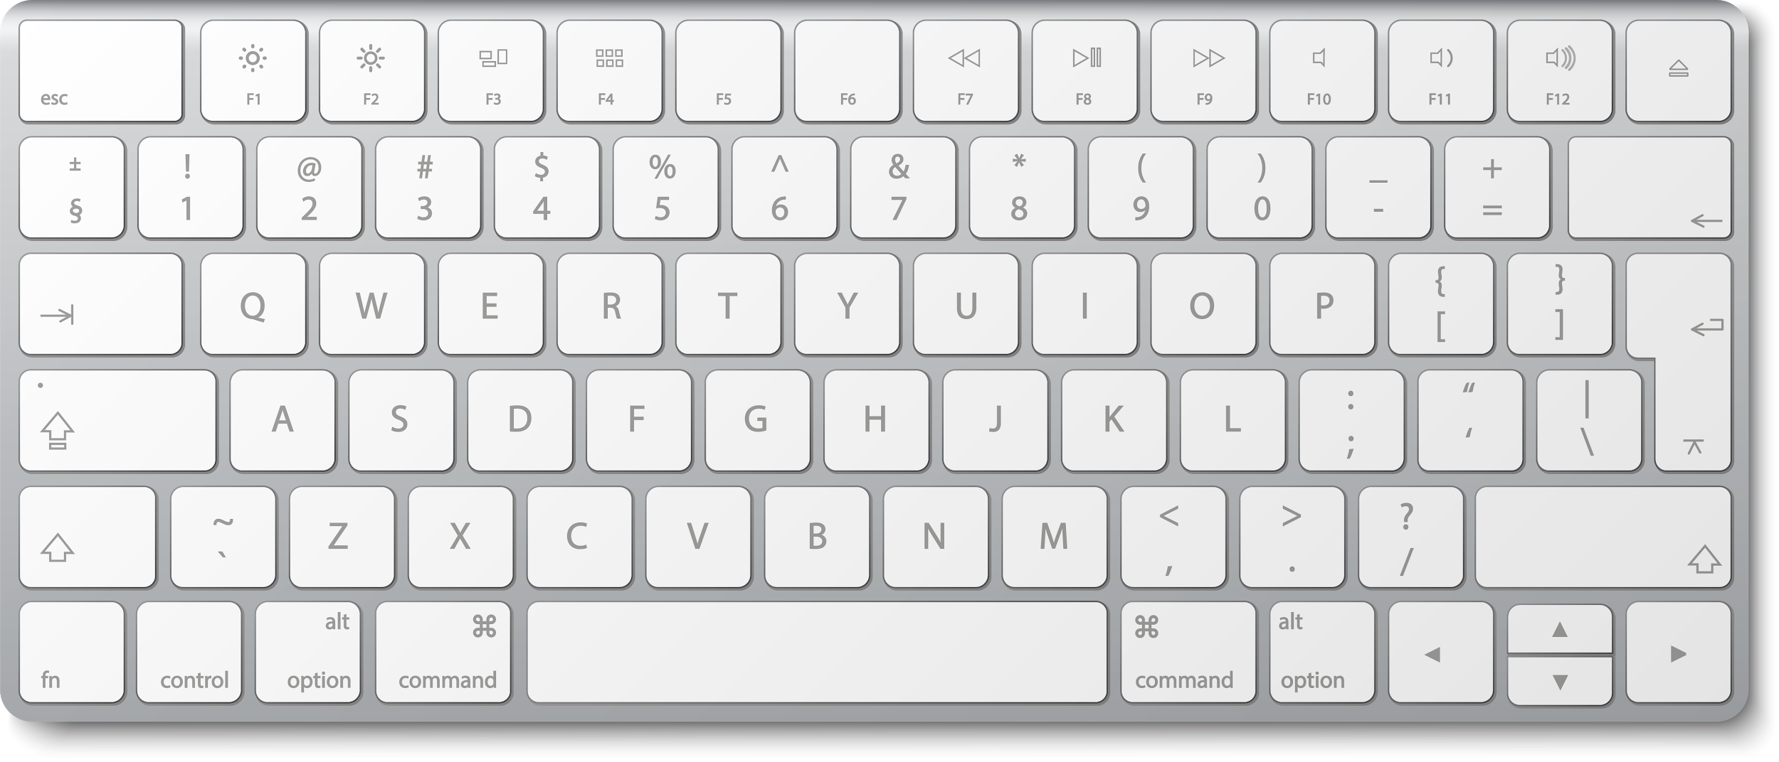
ASCII and The Decimal System
ASCII is used to represent computer-stored characters in a human-readable format.
Look down at you keyboards. Every character is part of ASCII. Upper and lowercase letters, special characters (!@#$...), and numbers (1,2,3,4…).
Notes:
shutterstock_497124181

Slide 24
The decimal system is a little more limited.
It consists of the characters 1, 2, 3, 4, 5, 6, 7, 8, 9, and 0.

Slide 25
ASCII and The Decimal System
The limited number of characters still allow us to convey complex information. In fact, anything we write in ASCII can be converted to decimal format.
ASCII Example
A, B, C. It’s easy as 1, 2, 3!
65 44 32 66 44 32 67 46 32 73 116 39 115 32 101 97 115 121 32 97 115 32 49 44 32 50 44 32 51 33
Decimal Example

Slide 26
Binary data can be more efficiently stored and represented by encoding with the hexadecimal number system.

Slide 27
Hex Encoding
The hex system uses 16 symbols to represent the base values.
0 1 2 3 4 5 6 7 8 9 A B C D E F
The base numbers range from 0-9.
The letters A-F represent 10-15.
hello = 68 65 6c 6c 6f

Slide 28

Encoding and Decoding Tools
There are various online tools to help with the encoding and decoding process.
Binary to Text Conversion browserling.com/tools/
binary-to-text
Character Encoding for Numbers
rapidtables.com/convert/number/
index.html
28
Notes:
Image source: shutterstock_523613047

Slide 29
Let’s practice decoding a
binary message using browserling.com.

Slide 30

Summary
We’re learning a lot of new concepts this week. Let’s review!
The goal of encoding isn’t to keep a message secret, but to transform data to be used by another system.
Encoding, unlike encryption, does not use a key.
Encoding is often used to transform digital text data into binary data, where encryption commonly takes place.
There are many types of encoding schemes available and each is relevant for different circumstances.
There are many free online resources, for encoding and decoding messages, such as browserling.com and rapidtables.com.
Notes:
shutterstock_336715625

Slide 31
Activity: Decoding
In this activity, you’ll continue to play the role of security analysts working for the Hill Valley Police Department.
There was another burglary last night. The bandit left behind an encoded message. You are tasked with decoding the message to determine the bandit's next target.
10 Minutes

Slide 33
Goals of Cryptography

Slide 34

Goals of Cryptography
Introducing the P.A.I.N model.
Privacy (Confidentiality)
Authentication
Integrity
Non-repudiation
Notes:
shutterstock_1382520854

Slide 35

Goals of Cryptography
Introducing the P.A.I.N model.
Privacy keeps data secure from unauthorized parties.
Notes:
shutterstock_1382520854

Slide 36

Privacy / Confidentiality
Data in motion: data moving between devices.
For example:
Bob sends an encrypted email to Alice, saying “The meeting is at noon.”
To protect the confidentiality of the data in motion,the email data moving across the internet between Bob and Alice would
need to be encrypted.
Notes:
shutterstock_1579176739

Slide 37

Privacy / Confidentiality
Data at rest: static data, such as that stored on a hard drive or in a database.
For example:
Data stored on your laptop.
To protect the confidentiality of this data at rest, the laptop's hard drive would be encrypted.

Slide 38

Goals of Cryptography
Introducing the P.A.I.N model.
Authentication is used to confirm the identities of the sender and receiver of data.
Notes:
shutterstock_1382520854

Slide 39

Authentication
Even when a message is encrypted, an attacker can still send encrypted data and claim they are someone they are not.
01
Bob sends a message to Alice: “The meeting is at noon.”
02
03
Scammer Tim sends an email impersonating Bob: “The meeting is cancelled.”
Alice receives the email.
Without authentication, Alice could be tricked into thinking the meeting is cancelled.
Disruptive Hacker
Notes:
shutterstock_1543992425

Slide 40

Goals of Cryptography
Introducing the P.A.I.N model.
Integrity ensures a message isn't altered between
when it's sent and when it's received.
Notes:
shutterstock_1382520854

Slide 41

Integrity
Even if a message is encrypted and the sender is authenticated, an attacker can still alter the contents of a message.
01
Bob sends a message to Alice: “The meeting is at noon.”
02
Scammer Tim sends an email impersonating Bob: “The meeting is at 5 a.m.”
03
Alice receives the email.
Disruptive Hacker

Slide 42

Goals of Cryptography
Introducing the P.A.I.N model.
Non-repudiation prevents the original sender from denying they were the sender.
Notes:
shutterstock_1382520854

Slide 43
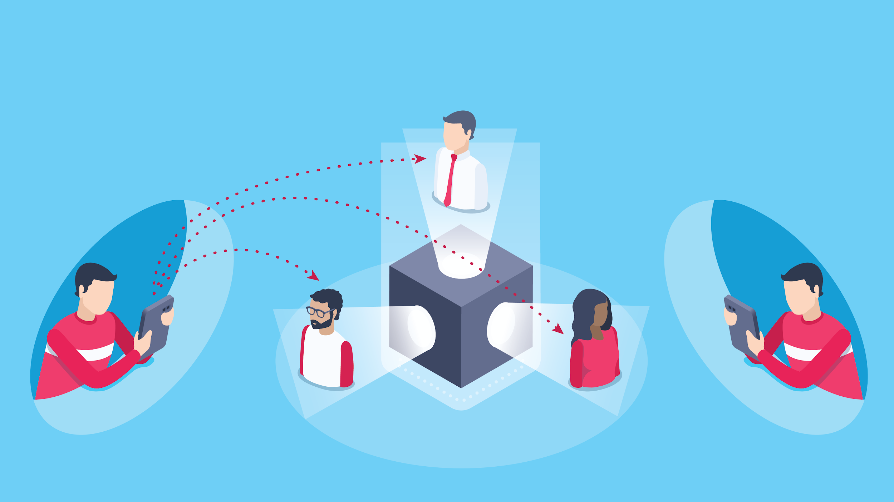
Non-Repudiation
Sends inappropriate message to coworkers...
I didn’t send that! I was hacked!
Notes:
shutterstock_1564838239

Slide 44
Cryptographic Ciphers

Slide 45
Stream ciphers apply their algorithm one bit (character) at a time.

Slide 46
Stream and Substitution Ciphers
One prominent stream cipher is the substitution cipher.
Substitution ciphers substitute out old values for new values of input message.
The Caesar and Enigma cipher are examples.
While substitution alone doesn’t provide strong encryption, when combined with other techniques it can provide strong, fast encryption.
Original
Key = 2
A
B
C
D
E
F
G
H
I
J
Encoded
A
B
C
D
E
F
G
H
I
J

Slide 47
Block ciphers apply their algorithm to chunks of characters.

Slide 48
Block and Transposition Ciphers
One prominent block cipher is the transposition cipher.
Transposition ciphers break an input message into equal-sized blocks and rearrange the letters of each block.
Break the message into blocks of three characters.
Replace the first, second, and third character of each block with the third , first, and second character.
Combine rearranged text.
Key =
1
2
3
Message
H
E
L
L
O
!
3
1
2
Encrypted Message
L
H
E
!
L
O

Slide 49
Summary
We’re learning a lot of new concepts this week. Let’s review!
The goals of cryptography illustrated with the P.A.I.N. model.
Stream ciphers apply algorithms one character at a time. Block ciphers apply algorithms to blocks of characters.
01
05
P.A.I.N. stands for Privacy, Authentication, Integrity and Non-Repudiation.
A type of stream cipher is the substitution cipher, and a type of block cipher is the transposition cipher.
02
06
03
07
Ciphers use mathematical formulas known as algorithms to encrypt and decrypt data.
Substitution ciphers replace each character with a completely different character.
04
08
The main cipher categories are block and stream ciphers.
Transposition ciphers rearrange the letters within a defined block size.

Slide 50
Activity: Cryptography Concepts and Cipher
In this activity, you’ll continue to play the role of security analysts working for the Hill Valley Police Department.
Your task is to use a found key to decrypt the most recent message left by the Alphabet Bandit.
10 Minutes

Slide 52

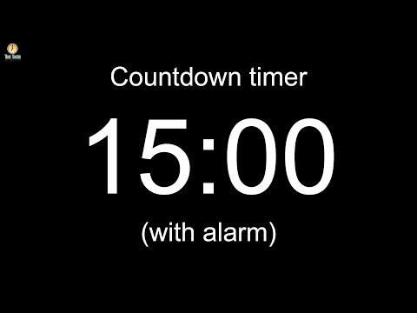
Notes:
Image source: AdobeStock_56885471

Slide 53
Modern Cryptography

Slide 54
As technology improved, so did methods for cracking ciphers.
Modern cryptography needed more complex algorithms and longer cryptographic keys.
Notes:
Image source: shutterstock_1083618569

Slide 55
Keys
Each algorithm has a possible range of numbers that can be used as a key, known as a key space.
For example, if a password could only be one numerical digits, the possible values are:
[
]
0
1
2
3
4
5
6
7
8
9
The key space is 10.

Slide 56
For modern cryptography, key space is defined by the number of binary bits used in the key, known as bit size.

Slide 57

Keys and Bit Size
You may hear the question:
“How much more secure
is x more bits of encryption?”
Notes:
shutterstock_1181047573

Slide 58
Keys and bit size
We’ll need to understand how bit size affects key space and the level of encryption.
For each bit added, the key space doubles in size.
Key space = 2 ^{bit size}
Key space = 2 (1, 0)
1 bit
2 bit
Key space = 4 (00, 01, 10, 11)
Key space = 8 (000, 001, 010, 100,
101, 110, 111)
3 bit

Slide 59
Encryption Strength (10-Bit and 30-Bit)

Slide 60
Class Activity: Encryption Strength
In this activity, you’ll continue to play the role of security analysts working for the Hill Valley Police Department.
In this activity, you will compare several email security vendors and choose the most cost-effective one for protecting future emails.
10 Minutes

Slide 61
Symmetric Key Algorithms

Slide 62
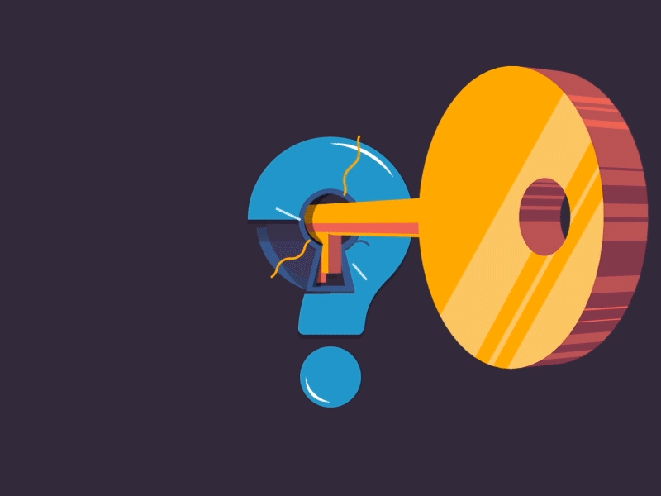
If larger bit size means stronger encryption, why don’t we just use a million-bit key?
Notes:
Image source: Arm Sattavorn

Slide 63
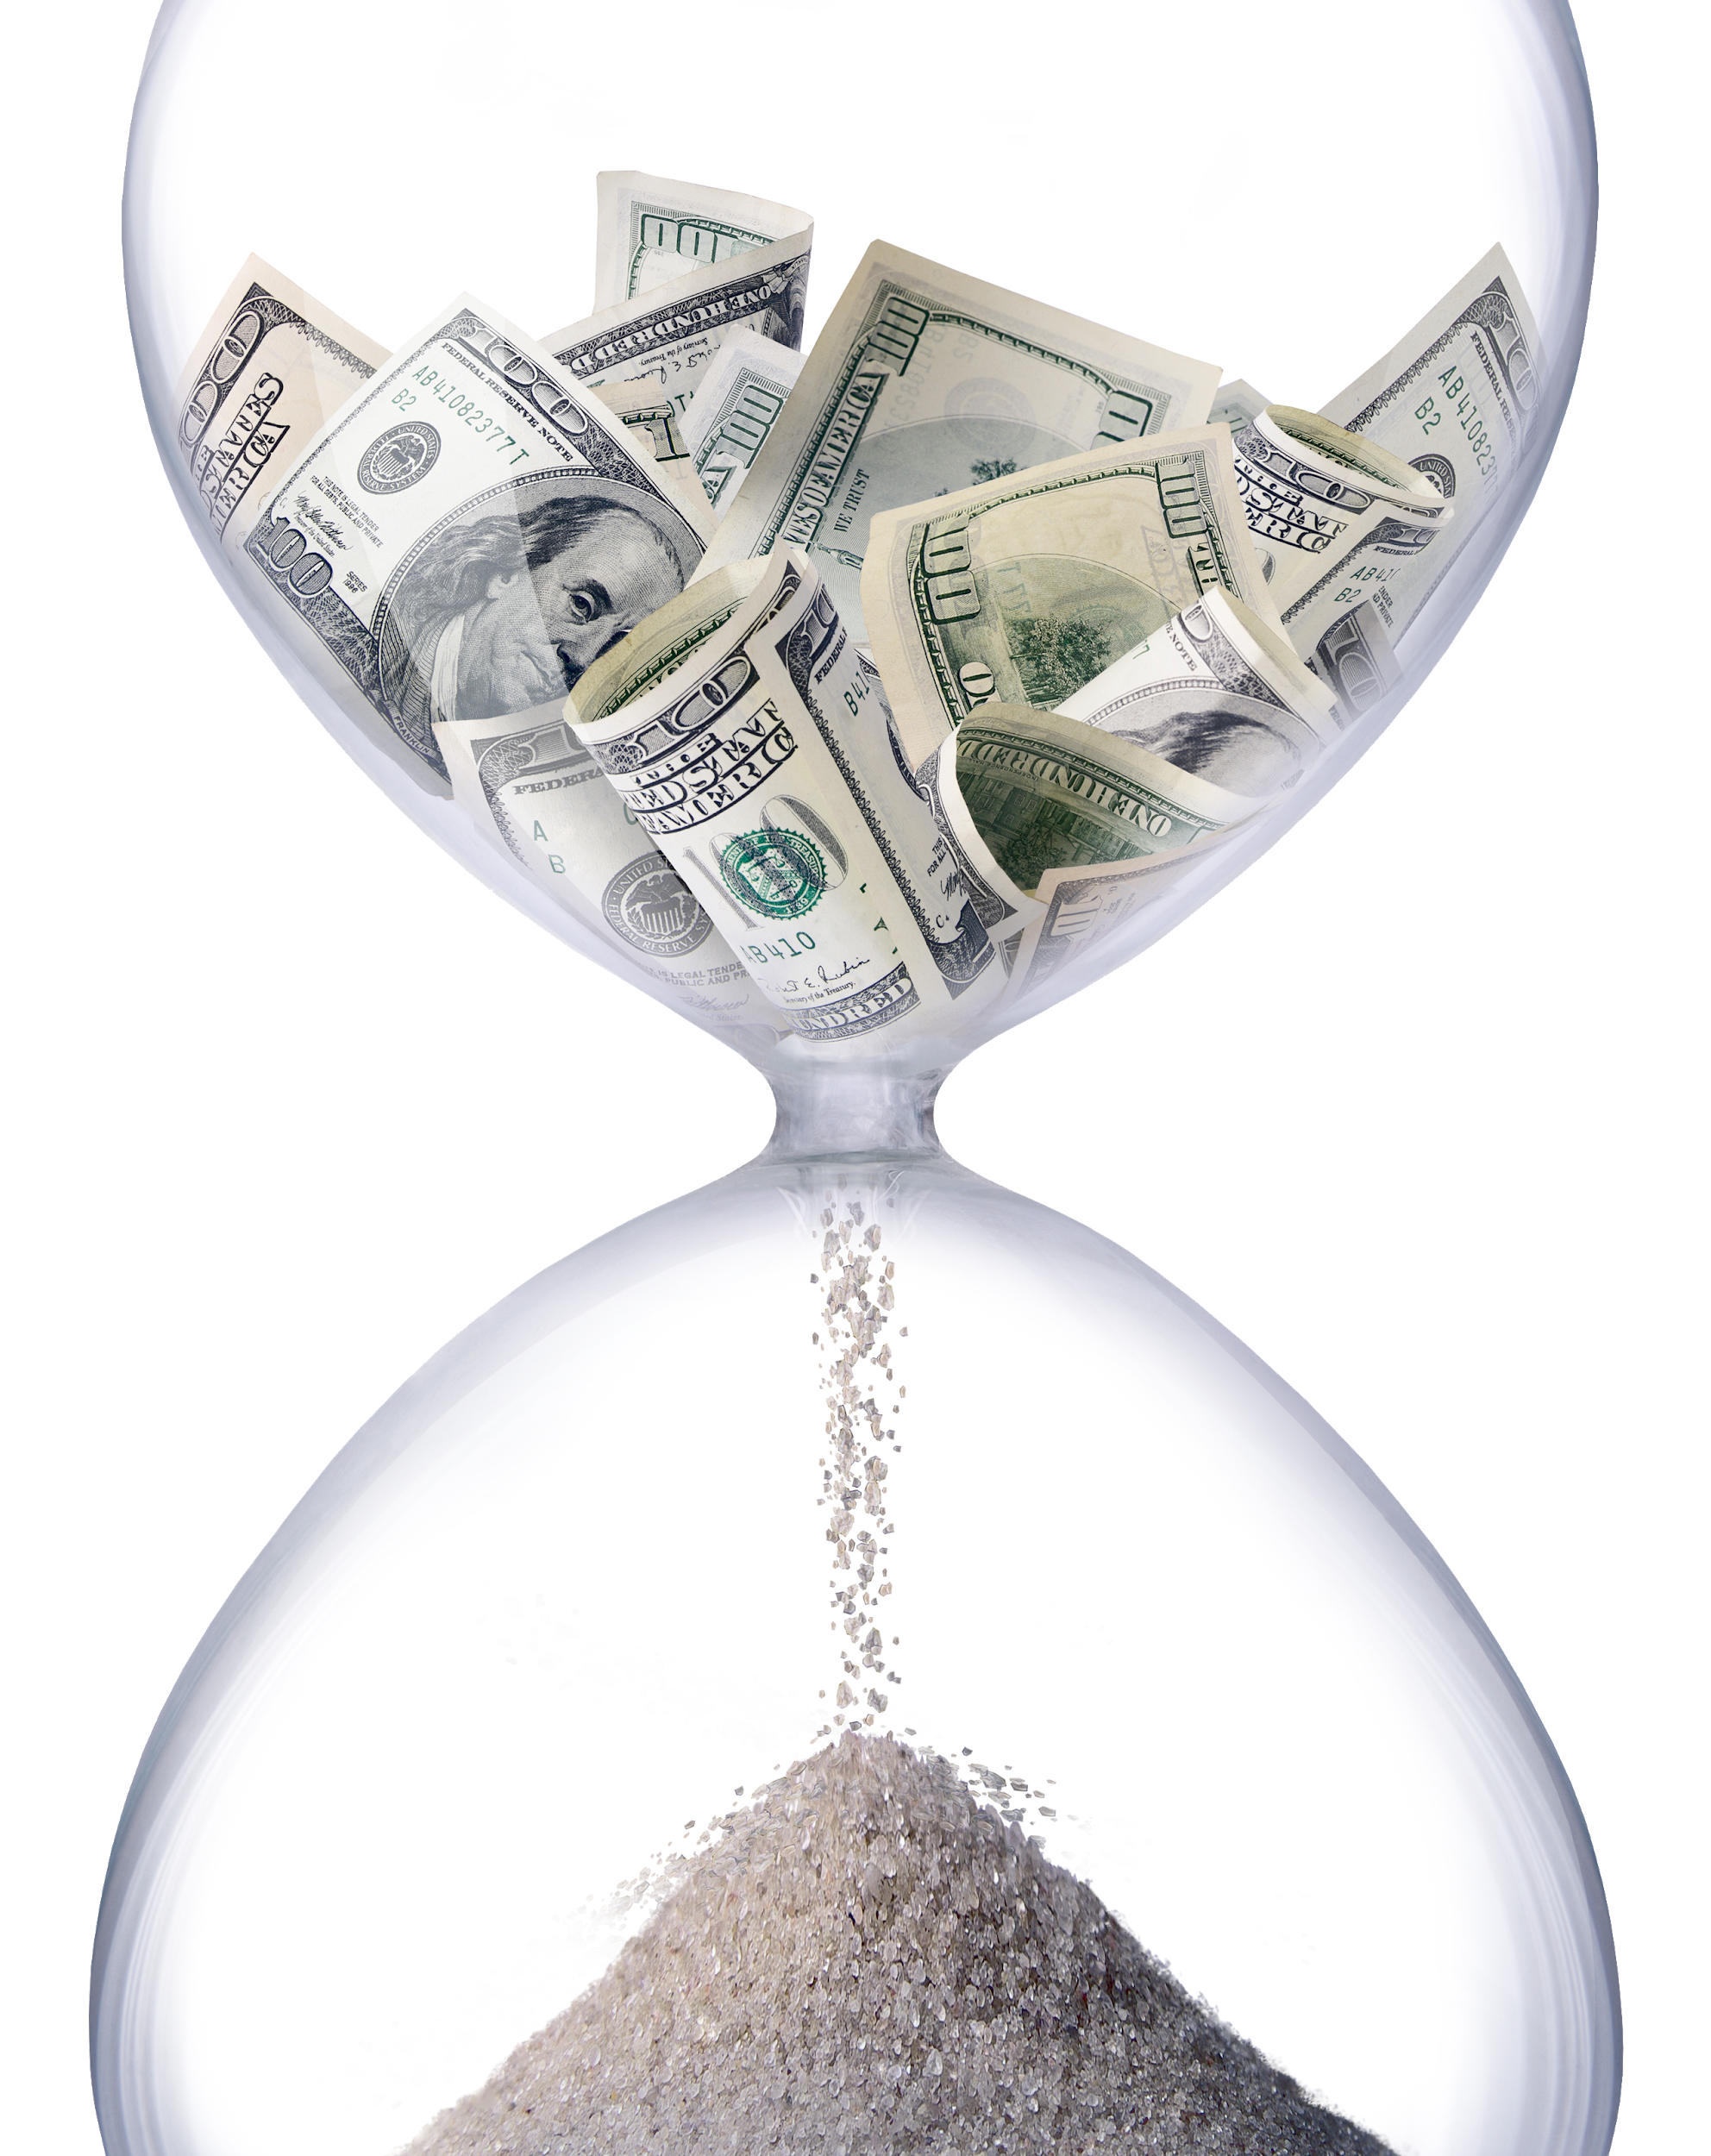
Security Tradeoffs
It takes time and computational resources to encrypt and decrypt larger keys.
Is the encryption strength worth the time to use
the key?
Notes:
shutterstock_58785163

Slide 64

Security Tradeoffs
Do we want an incredibly strong cipher that’s hard to compute and difficult to decrypt?
Or, do we prefer average security that’s faster?
Notes:
shutterstock_1619544745

Slide 65
Modern symmetric key algorithms use algorithms that are secure and fast.

Slide 66

Finding the Balance
Symmetric key algorithms use a single, shared key to encrypt and decrypt a message.
This shared key needs to remain private. If exposed, the message can be decrypted by anyone.
Some widely known symmetric key algorithms include:
Data Encryption Standard (DES),
Triple DES (3DES)
Advanced Encryption Standard (AES)
Notes:
shutterstock_1626701869

Slide 67

Data Encryption Standard (DES)
DES is a 56-bit key published by the United States government in 1977.
Flaws were found in DES and additional security was added to create Triple 3DES.
However, the security community banded together to develop a newer, more secure symmetric encryption algorithm.
Notes:
shutterstock_1127482970

Slide 68
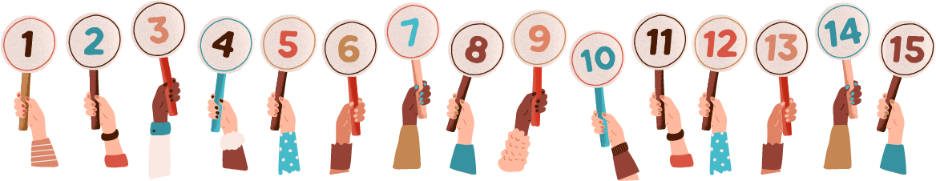
Advanced Encryption Standard
In 1997, the National Institute of Standards and Technology (NIST) announced they were seeking a replacement for DES.
NIST opened a contest for cryptographers to submit algorithms.
In the first round, 15 submissions were collected.
The community attempted to break them all.
The five most promising moved on.
Notes:
shutterstock_1311779129

Slide 69

Advanced Encryption Standard
In 1997, the National Institute of Standards and Technology (NIST) announced they were seeking a replacement for DES.
In the second round, the five algorithms were subjected
to extensive cryptanalysis
by the community.
Notes:
shutterstock_1104834494

Slide 70

Advanced Encryption Standard
Eventually the Rijndael cipher was determined to be the strongest.
After it was refined and standardized, it became the Advanced Encryption Standard.
It is available in 128, 192, and 256-bits.
Notes:
shutterstock_692406511

Slide 71
Now we’ll use the command-line tool OpenSSL to encrypt and decrypt data.
Notes:
Image source: shutterstock_1083618569

Slide 72
OpenSSL

Slide 73
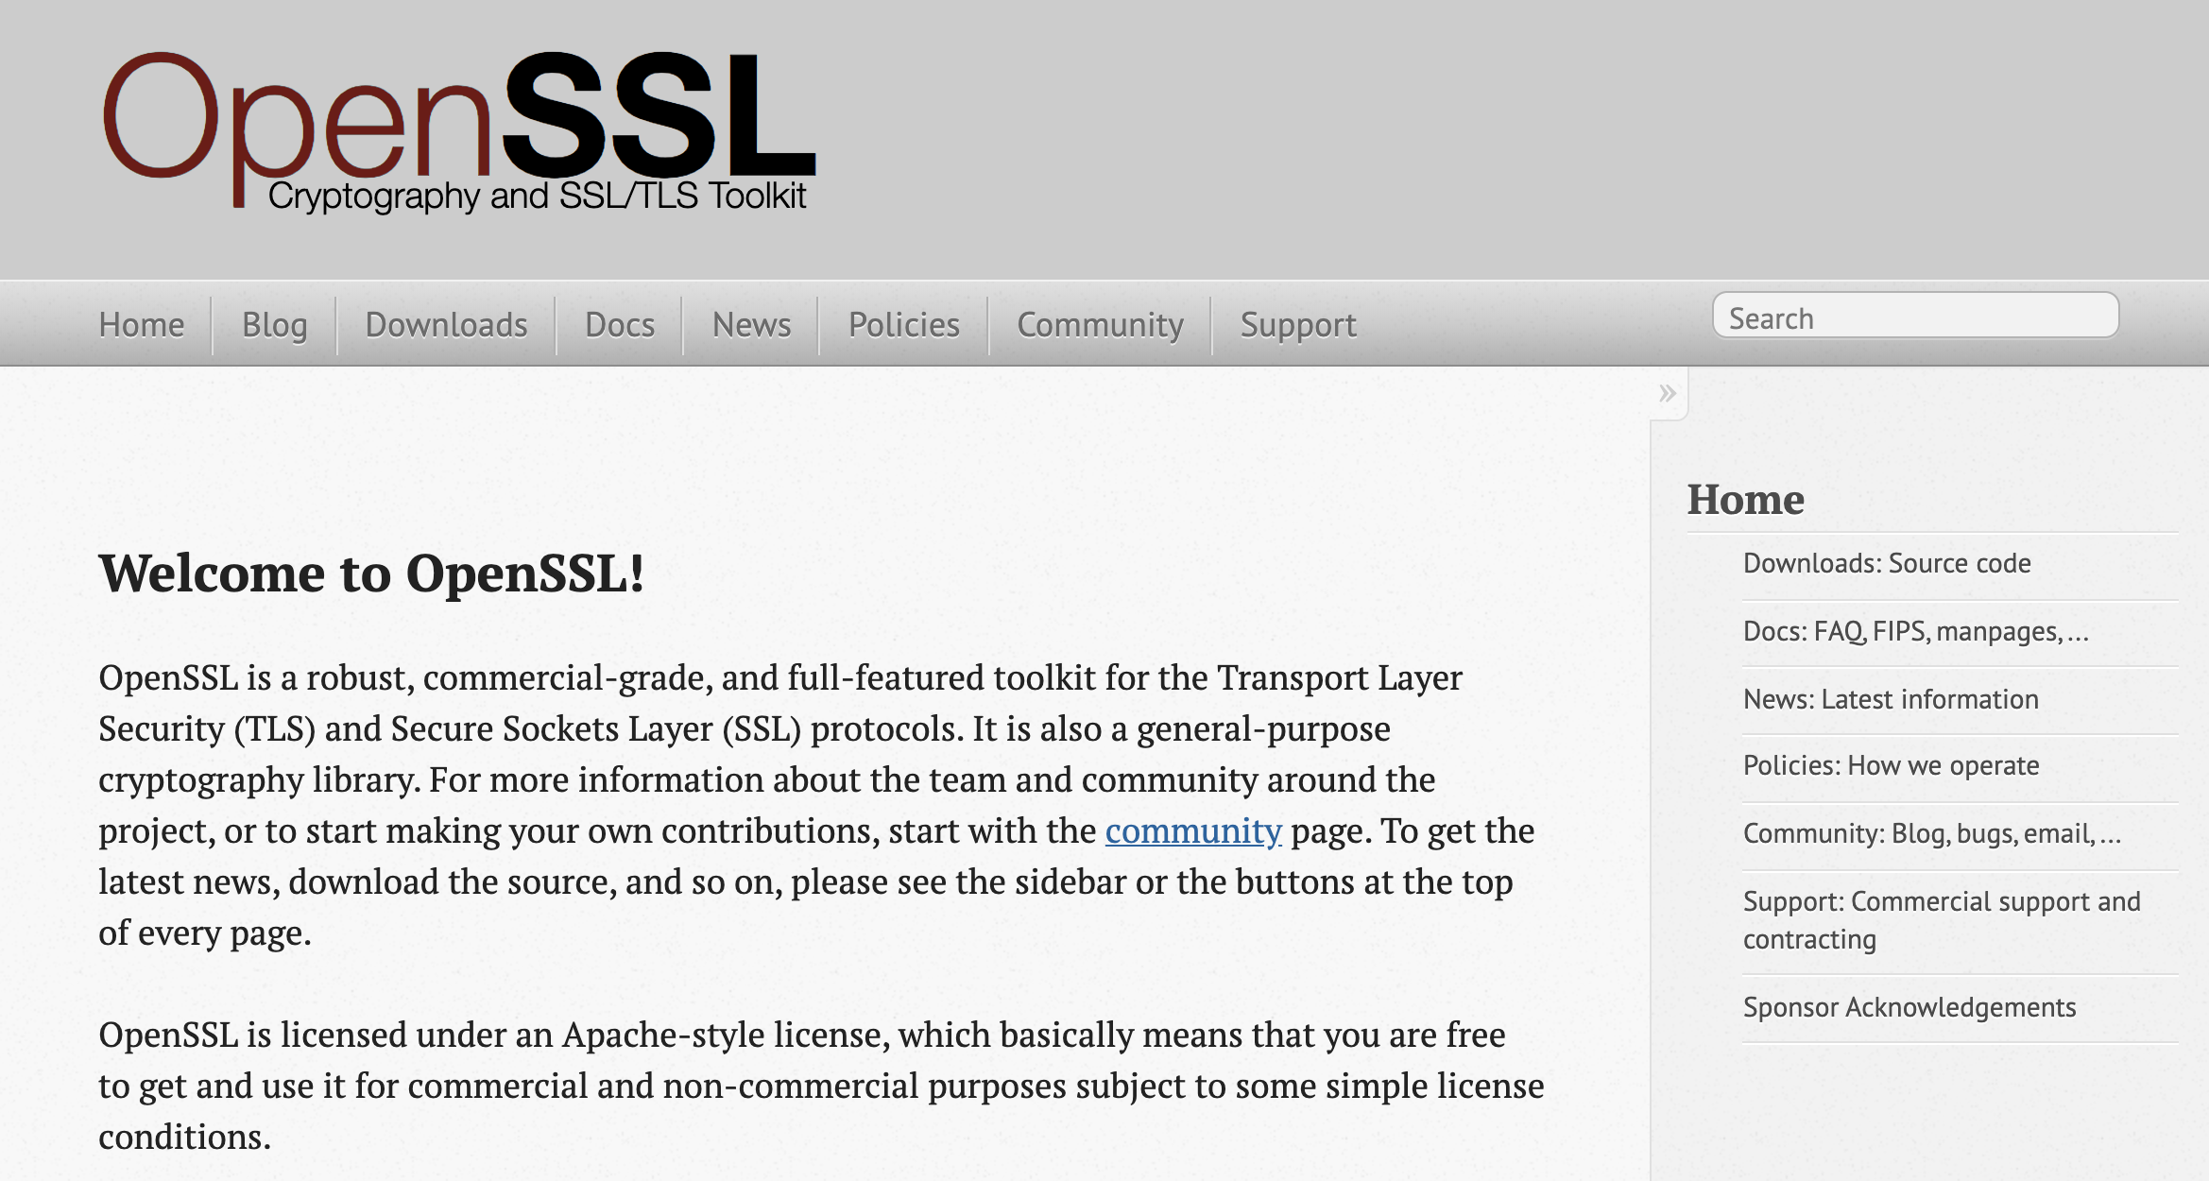
Demo Summary
OpenSSL is a free command-line tool used for symmetric encryption and decryption.
01
OpenSSL can generate a random key and initialization vector (IV).
02
With the key and IV, OpenSSL can encrypt and decrypt a message with simple terminal commands.
(OpenSSL)

Slide 74
Demo Summary
Creating the key and IV:
openssl enc -pbkdf2 -nosalt -aes-256-cbc -k mypassword -P > key_and_IV
Encrypting:
openssl enc -pbkdf2 -nosalt -aes-256-cbc -in plainmessage.txt -out plainmessage.txt.enc -base64 -K 89E01536AC207279409D4DE1E5253E01F4A1769E696DB0D6062CA9B8F56767C8 -iv EE99333010B23C01E6364E035E97275C
Decrypting:
openssl enc -pbkdf2 -nosalt -aes-256-cbc -in plainmessage.txt. enc -d -base64 -K 89E01536AC207279409D4DE1E5253E01F4A1769E696DB0D6062CA9B8F56767C8 -iv EE99333010B23C01E6364E035E97275C

Slide 75
Activity: OpenSSL
In this activity, you’ll continue to play the role of security analysts working for the Hill Valley Police Department.
You must use OpenSSL to decrypt a message from the police captain.
10 Minutes

Slide 77
Questions?

